Slide 1
A CHURCH
Selecting
Of God’s Choice

Slide 2
A CHURCH
How NOT To Select

Slide 3
AVOID
THESE
Location
  Car dealership?
  Employment?
  Marry a person?
  Doctor?
“right around the corner”

Slide 4

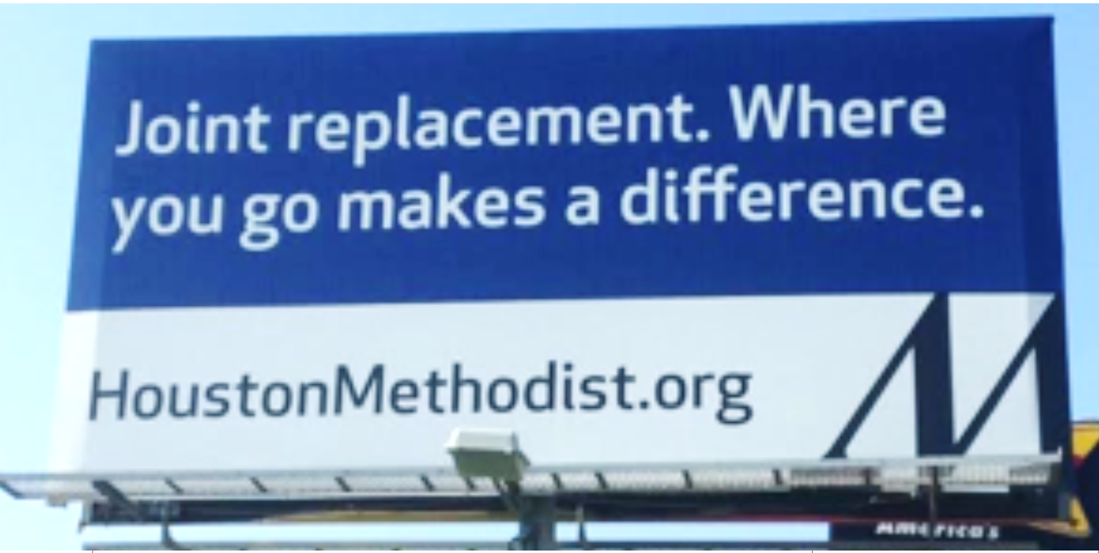

Slide 5
AVOID
THESE
Location
Architectural Beauty
Ephesians 5:22ff
Christ as loving head and savior of
The church as the baptized, saved, subjective, nourished an cherished, members
Fears (Acts 5:11)
Ears (Acts 11:22)
Prayers (Acts 12:5)
The Church
(people)
"God, who made the world and everything in it…does not dwell in temples made with hands” (Acts 17:24)
(saved people)
(not building)

Slide 6
AVOID
THESE
Location
Architectural Beauty
Friends and Relatives
John 7:3-5
Luke 6:20-26
Matthew 10:34-36
Matthew 12:46-50
John 15:14
Friendship With Christ
Is What Matters!

Slide 7
AVOID
THESE
Location
Architectural Beauty
Friends and Relatives
Size of membership
1 Samuel 17
Judges 8:4, 10
Matthew 7:13, 14
1 Peter 3:20
Exodus 23:2
Size Does Not
Make Right!

Slide 8
AVOID
THESE
“And whatever you do in word or deed, do all in the name of the Lord Jesus, giving thanks to God the Father through Him” (Col. 3:17)
Location
Architectural Beauty
Friends and Relatives
Size of membership
Social Activities
Where is the authority for the church to engage in social and recreational activities?

Slide 9
Authority
}
Command
To authorize the church to arrange / support a common meal for social and recreational purposes
Example
Necessary
Inference
If there is, where is the passage?

Slide 10
How To Determine What Is
Authorized
Lord’s Supper
Command/
Direct
Statement
Approved
Example
Necessary
Inference
Observance
1 Cor. 11:23-24
Time
Acts 20:7
Frequency
Acts 20:7

Slide 11
Authority
Command | Aid
Eat Bread – 1 Cor. 11 | Table, plates …
Baptize – Matt. 28:19 | Baptistry, heater
Sing – Eph. 5:19 | Books, Tuner
Contribute – 1 Cor. 16 | Basket, Account
Provide meals for social & rec. purposes (???) | Kitchen, Fellowship Hall
Question:
Where is the
Authority?

Slide 12
One might respond…
“We have restrooms, sinks, water fountains, and cry rooms, why not a kitchen?”
These are not provided for entertainment
These are expedient accommodations for the command to assemble (Heb. 10:25)
  They fall in with song books for singing, lights for seeing, heat for winter, and air conditioning for summer meetings
  Would it make sense to advertise?
    “Join in fellowship at the church restroom!”
    “Join us at 7:30 for a ‘water drinking’ at the church fountain!”

Slide 13
  Acts 2:42, “And they continued steadfastly in the apostles’ doctrine and fellowship, in the breaking of bread, and in prayers.”
Does Acts 2:42 authorize a church kitchen?
“IF” redefine “fellowship” as “eating together”
I could authorize a “church arcade” by defining “fellowship” as playing together!
  “fellowship” (2:42) is imagined to mean eating common meals together…does it make sense?
  “And they continued steadfastly in the apostles’ doctrine and eating common meals together, in the breaking of bread, and in prayers?”

Slide 14
  Acts 2:42, “And they continued steadfastly in the apostles’ doctrine and fellowship, in the breaking of bread, and in prayers.”
“Fellowship” in Acts 2:42 DOES NOT authorize a church kitchen?
  CONTEXT…“fellowship” here means sharing in a gift or contribution (2:44, 45; 4:34-37)
    They had the same standard—apostolic doctrine
    They had the same faith—all who believed
    They had the same care—sold possessions and goods to provide for any believer who had need (2:44, 45)
      Not, “they constructed a large kitchen and hall so that they could eat fried chicken and coleslaw together”

Slide 15
  Acts 2:42, “And they continued steadfastly in the apostles’ doctrine and fellowship, in the breaking of bread, and in prayers.”
Does “breaking of bread” in Acts 2:42 authorize a church to “Bake Bread” for a common meal?
  The “breaking of bread” is distinguished from “fellowship” and “prayers”
    It does not mean there is no fellowship in “the breaking of bread”
    It does not mean there are no prayers connected with “the breaking of bread”
    It DOES mean that it is distinguished from the others as its own separate act: The Lord’s Supper (1 Cor. 11:20)

Slide 16
  Acts 2:46, “So continuing daily with one accord in the temple, and breaking bread from house to house, they ate their food with gladness and simplicity of heart”
Does Acts 2:46 authorize a church kitchen?
  No mention of such
  No example of such
  No necessary implication of such
They continued daily with one accord in the
temple—for worship
Suitable for 3000 people to assemble (2:41)

Slide 17
  Acts 2:46, “So continuing daily with one accord in the temple, and breaking bread from house to house, they ate their food with gladness and simplicity of heart”
  Breaking bread was from “house to house”
    Distinct from the bread in 2:42, viz., “their food” versus “Lord’s Supper”
    (1 Cor. 11:20, 22)
    Shows there was not a place built by the church to house such a work to eat “from house to house”
    The very passage proponents use in support of a “church kitchen” and an “eating hall” actually denies both!

Slide 18
If A PASSAGE Existed Like
“What! Do you not have church buildings to eat and drink in?”
“But if anyone is hungry, let him eat in the fellowship hall”
But rather we read:
  “for the kingdom of God is not eating and drinking…” (Rom. 14:17)
  “What! Do you not have houses to eat and drink in? Or do you despise the church of God and shame those who have nothing? …”
  (1 Cor. 11:22)
  “But if anyone is hungry, let him eat at home…” (1 Cor. 11:34)

Slide 19
Location
Architectural Beauty
Friends and Relatives
Size of membership
Social Activities
AVOID
THESE

